Slide 1
Final Project
Eric Gunnarson

Slide 2
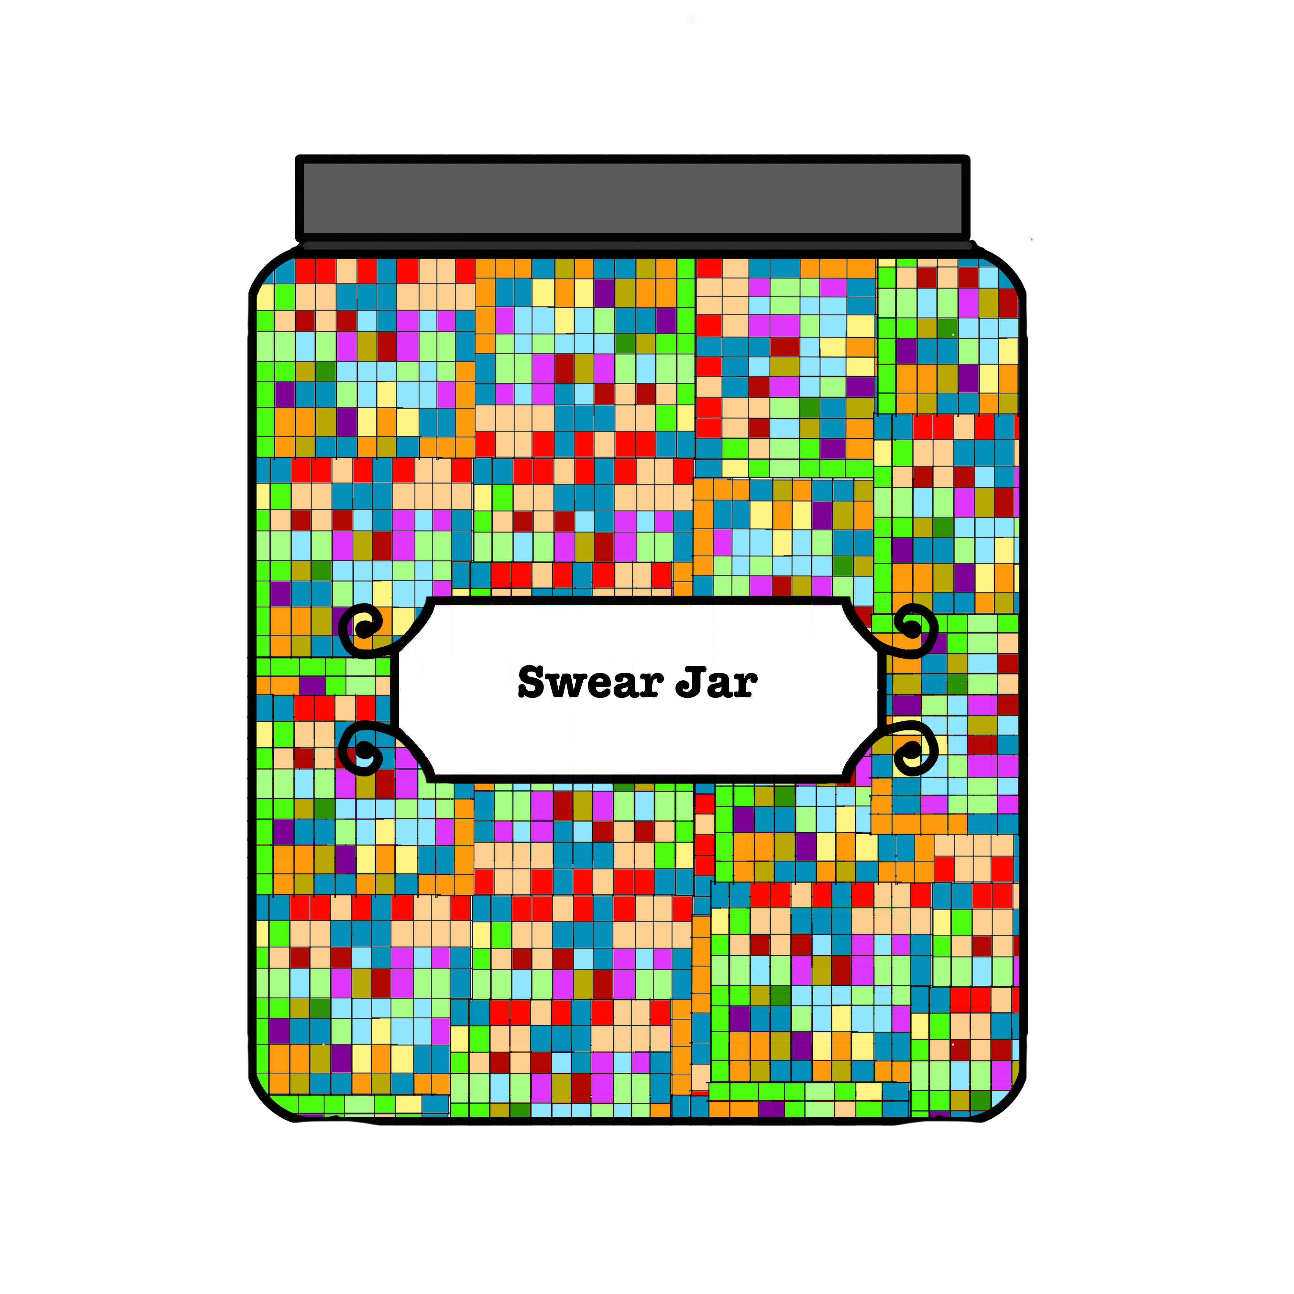
Machine Learning in an Art Piece

Slide 3
The Swear Jar
Pulls Social media posting content
Uses machine learning to sort and prioritize posting data
Creates visual map of data in jar

Slide 4
Input:
Swear words used in posting
Local context clues in posting

Slide 5
Processing:
Sorts and organizes posting as such:
The swear word category:
Non directed swears
Swears depreciating a group
Slurs
Swear context:
Directed at inanimate object
Directed at political/social group/organization
Hate speech/targeted attack

Slide 6
Output:
Translates data values assigned to categories into color and Brightness values
(ex. non-directed swear = low brightness, inanimate object subject=blue.)
Outputs values to “Jar”display

Slide 7
Result:
A real time view of swearword use in social media.
An interesting commentary on how we use derogatory language
A funny tool for any heated political engagement…

